Slide 1
Pre-processing text (Noise Removal)
<h1>THIS IS A TEST MESSAGE \N</h1>
Strip HTML
Remove Encoding Parts
Lower Text
THIS IS A TEST MESSAGE \n
THIS IS A TEST MESSAGE
this is a test message
Tokenize Text
[this , is , a , test , message]

Slide 2
Pre-processing cont. (normalization)
These are 2 test messages
Replace Numbers
These are two test messages
Remove Stop Words
[two , test , messages]
Stemming
[two , test , mesg]
Lemmatization

Slide 3
Feature extraction
TF-IDF
Linguistic Inquiry and Word Count (LIWC2)
Sentiment Analysis
Capturing pronouns

Slide 4
Processing
Classifiers
SVM
Random Forest

Slide 5
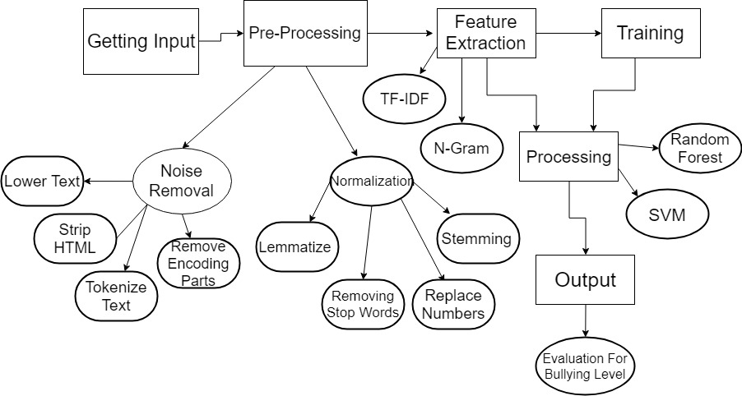
Wrap up diagram

